Slide 1
Getting Started with Test Automation
Part 5: DRY, KISS, YAGNI and Inheritance

Slide 2
Lunch n’ Learn Materials
All slides, example code, and any other material from these lunch sessions is available.
All examples can be viewed/copied from GoogleDrive
https://drive.google.com/open?id=0BwPovPyaC-TnT3FsbnYzZjk3NUU
Code examples are in the Examples folder. Copy the entire folder Part_5_DRY_Inheritance to the location below( on Windows). If you have installed any packages, you will already have the node_modules\ folder. You may need to create the projects\ directory inside of the already existing node_modules\ if you have not already done so.
C:\Users\your.user.name\AppData\Roaming\npm\node_modules\projects\

Slide 3
The DRY, KISS and YAGNI Principles
Three Software Principles to Practice in Our Tests
DRY - Don’t Repeat Yourself
In a nutshell, the DRY principle just means that we try to write common functionality once
This makes our tests less fragile
KISS - Keep It Simple, Stupid
Use the simplest solution that works
Don’t overcomplicate your test frameworks
YAGNI - You Aren’t Gonna Need It
Only build in features when they are needed
The primary goal of a test framework is to test something

Slide 4
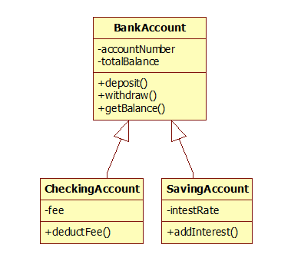
Classical Inheritance: What is it?
SuperClass / BaseClass - Classical Inheritance (C++, Java, C#)
Everything inherits from a class called Object
A class can inherit attributes and methods/functions ()
from another class
Models an “Is a” relationship
BankAccount is the superclass
CheckingAccount and SavingsAccount both
extend/inherit from BankAccount
A CheckingAccount is a BankAccount
A CheckingAccount inherits all the attributes and methods
from its superclass, but also can have it’s own attributes
and methods

Slide 5
Prototypal Inheritance: What is it?
Object Prototypes - Prototypal Inheritance (JavaScript)
A similar concept, but without a distinct concept of Class. Instead, let’s call them supertypes and subtypes. Subtype inherits from its supertype.
All objects inherit inherit methods from a prototype
This creates a chain of inheritance
All objects you create inherit from Object.prototype by default
You can specify another prototype for your objects

Slide 6
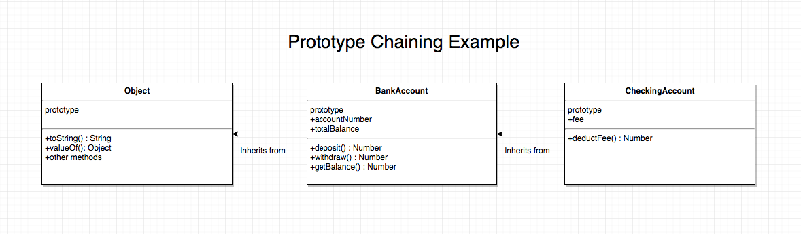
Prototypal Inheritance: Continued
From our previous example, we could specify that CheckingAccount should use the BankAccount prototype
Let’s create inheritance by setting the CheckingAccount prototype = BankAccount prototype.
CheckingAccount.prototype = Object.create(BankAccount.prototype)

Slide 7
Prototypal Inheritance: What about properties?
Constructor Stealing - to inherit properties from the supertype, we need to call the constructor for the supertype from the subtype constructor.
This is confusing, but likely won’t be necessary in more than 1 or 2 places in our test framework.
//Our subtype constructor
Function CheckingAccount(acctNumber) {
//Here we’ll use the call() method to the supertype constructor
BankAccount.call(this, acctNumber);
}
For our purposes, we’ll create a prototype that all of our page objects inherit.
We can call it BasePage.js (or SuperPage.js if you prefer)

Slide 8
Let’s apply these principles
BasePage - pull the common functionality into a BasePage module and let our page objects inherit from it.
Base Test - The mocha methods beforeEach() and afterEach() are the same for every test. Let’s put them into a BaseTest module
We won’t use prototypal inheritance here. Mocha has another approach that will work for us.
Add a require statement to each test. This lets us use the BaseTest’s beforeEach and afterEach methods.
ProjectProperties - Put the project configuration properties in its own file. We can reference things like URLs, browser types, timeouts and other values we want to apply to all tests, but not hardcode

